Slide 1
Analysis of the white wine and the red wine data sets
The two analyzed datasets are related to red and white variants of the Portuguese "Vinho Verde" wine

Slide 2
Both datasets have the following variables
1 - fixed acidity 2 - volatile acidity 3 - citric acid 4 - residual sugar 5 - chlorides 6 - free sulfur dioxide 7 - total sulfur dioxide 8 - density 9 - pH 10 - sulphates 11 - alcohol Output variable (based on sensory data): 12 - quality (score between 0 and 10)

Slide 3
Research Questions
Is there a statistically significant correlation between pH and the citric acid concentration for the white wine
Is there a statistically significant correlation between pH and the sulphates concentration for the white wine
I chose 5 variables for both the red wine and the white wine- citric acid, residual sugar, pH, total sulfur dioxide, and sulphates to build a logistic regression model predicting the quality of wines (low quality or high quality).
Finally, I evaluated whether the residual sugar concentration of the red wine statistically significant differs from that of the white wine.

Slide 4
EDA analysis
To start analyze these two data sets I imported the data by running the code:
red=pd.read_csv("df1.csv")
white=pd.read_csv("df2.csv")
To address to the third research question I created a new variable-”quality_binary”. This variable has only two values. A zero corresponds to values from 0 to 5 of the quality variable and represents a wine with a low quality. A one corresponds to values greater than 5 of the quality variable and represents a wine with high quality. The quality variable contains values that are characterized the quality of wine in integers varying from one to ten. To create a new variable I run the code:
red["quality_binary"]=np.where(red["quality"]>5, 1, 0)
white["quality_binary"]=np.where(white["quality"]>5, 1, 0)

Slide 5
Analysis of column names and shape of data sets
This is the number of rows and columns for the red wine dataset: (4898, 14) This is the number of rows and columns for the white wine dataset: (1599, 14)
This is the number of rows and columns for the red wine dataset: (4898, 14) This is the number of rows and columns for the white wine dataset: (1599, 14)
This is the number of rows and columns for the red wine dataset: (4898, 14) This is the number of rows and columns for the white wine dataset: (1599, 14)
To confirm that columns names corresponds to the column names in documentation I ran the code:
print("These are columns names for the red wine dataset:", red.columns)
print("These are columns names for the white wine dataset:", white.columns)
I analyzed the shape of datasets:The red wine dataset contains 4898 rows and 14 columns while the white wine dataset contains 1599 rows and 14 columns
I checked whether following variables -citric acid, residual sugar, pH, total sulfur dioxide, and sulphates are normally distributed by running normal test. Both the white wine and the red wine datasets they are not normally distributed based on the normal test results.

Slide 6
The mean values
 | White Wine | Red wine
Citric acid | 0.271 | 0.334
Sulphates | 0.658 | 0.490
pH | 3.311 | 3.188
Residual sugar | 2.539 | 6.391
Total sulfur dioxide | 46.468 | 138.361

Slide 7
Standard Deviation
 | White Wine | Red wine
Citric acid | 0.195 | 0.121
Sulphates | 0.170 | 0.114
pH | 0.154 | 0.151
Residual sugar | 1.41 | 5.072
Total sulfur dioxide | 32.90 | 42.498

Slide 8
The minimum values
 | White Wine | Red wine
Citric acid | 0.0 | 0
Sulphates | 0.330 | 0.220
pH | 2.740 | 2.72
Residual sugar | 0.90 | 0.6
Total sulfur dioxide | 6.0 | 9.0

Slide 9
The first quartile
 | White Wine | Red wine
Citric acid | 0.090 | 0.27
Sulphates | 0.550 | 0.410
pH | 3.210 | 3.09
Residual sugar | 1.90 | 1.70
Total sulfur dioxide | 22.00 | 108.0

Slide 10
The median values
 | White Wine | Red wine
Citric acid | 0.260 | 0.320
Sulphates | 0.620 | 0.470
pH | 3.310 | 3.180
Residual sugar | 2.20 | 5.20
Total sulfur dioxide | 38.00 | 134.00

Slide 11
The third quartile values
 | White Wine | Red wine
Citric acid | 0.420 | 0.390
Sulphates | 0.730 | 0.550
pH | 3.40 | 3.280
Residual sugar | 2.60 | 9.900
Total sulfur dioxide | 62.0 | 167.0

Slide 12
The maximum values
 | White Wine | Red wine
Citric acid | 1.0 | 1.660
Sulphates | 2.0 | 1.080
pH | 4.010 | 3.820
Residual sugar | 15.500 | 65.800
Total sulfur dioxide | 289.0 | 440.0

Slide 13
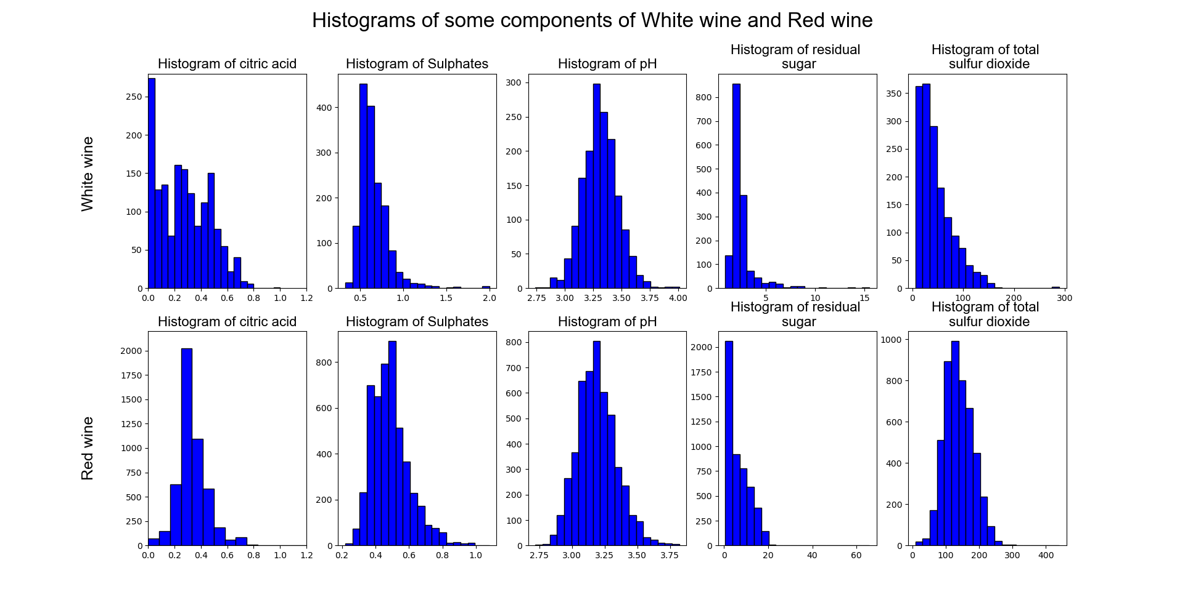

Slide 14
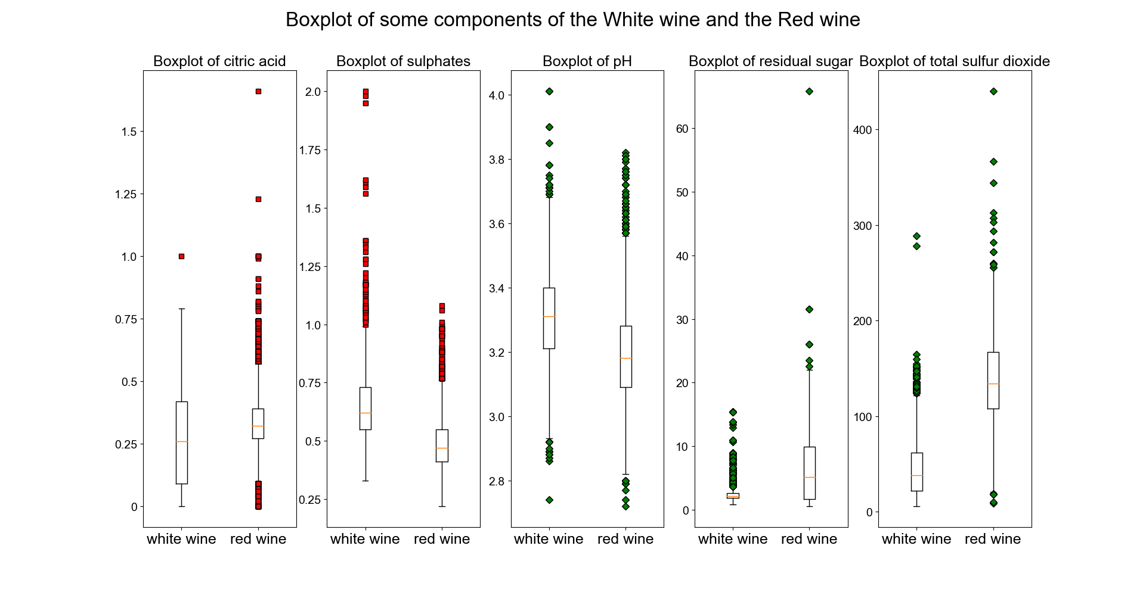

Slide 15
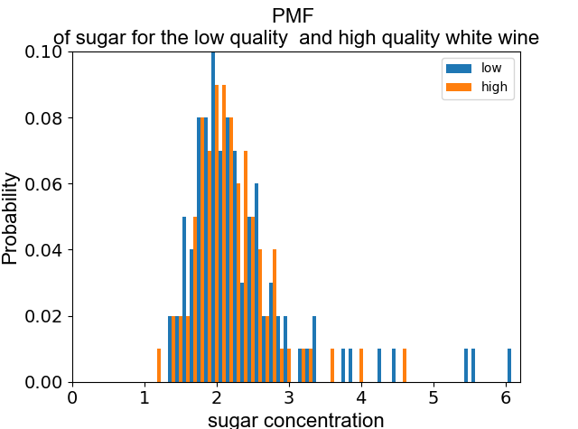
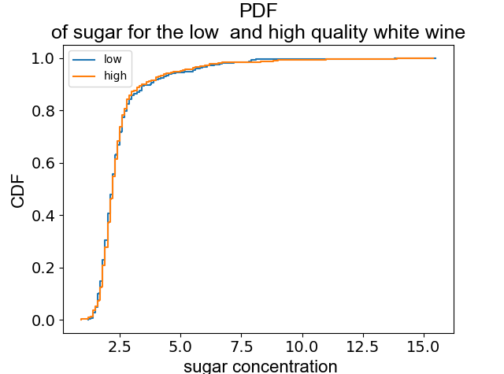
I separated the white wine data frame on the low and high data frames. The low data frame contains
data for low quality white wine (quality_binary==0) and high quality white wine (quality_binary==1).
I created PMF and PDF plot for the sugar concentration for both high quality and low quality white
wine.

Slide 16
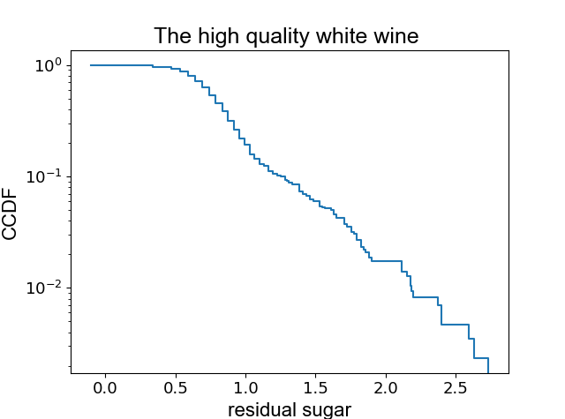
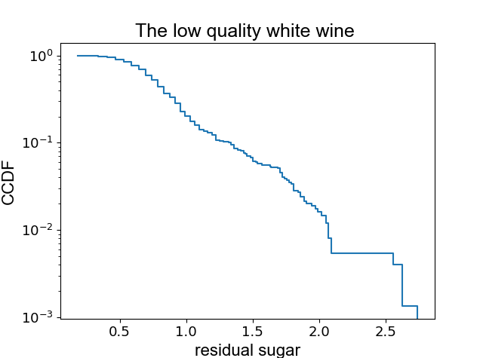
To address to analytical distribution of residual sugar both in the low quality white wine and the high
quality of white wine I run the normal test for the residual sugar variable and normal test for
log(residual sugar). Both tests showed that residual sugar does not have both normal and lognormal
Distribution (p<0.05). To check if it can be modeled by an exponential distribution I plotted CCDF of
log(residual sugar). If the distribution is linear the graph should be linear or close to linear. We see that
the sugar concentration for low quality wine can be considered as linear in the range 0.6-2. While the
sugar concentration for the high quality wine can be modeled by two straight lines with different slopes.
One line can model the range 0.6-1 and another line can model 1-2.5 range of concentration. We can model
both distributions by exponential distributions

Slide 17
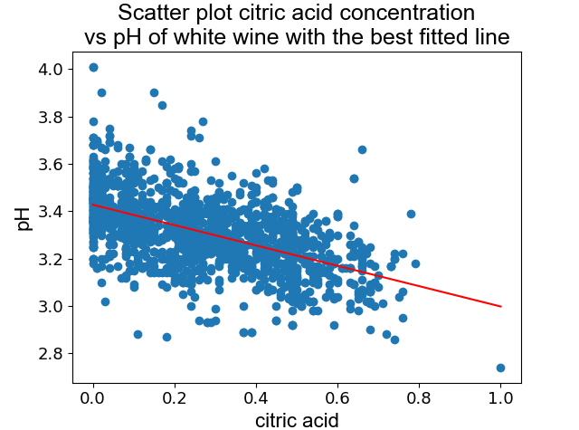
As a part of EDA covariance and correlation coefficient for citric acid concentration and pH were computed
and a scatter plot was created for these variables with the best fitted line.
covariance=-0.0162
Spearman coefficient=-0.548
p value=0
confidence interval=(-0.041, 0.04)

Slide 18
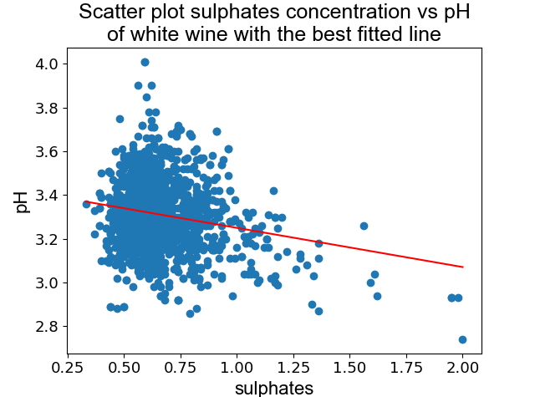
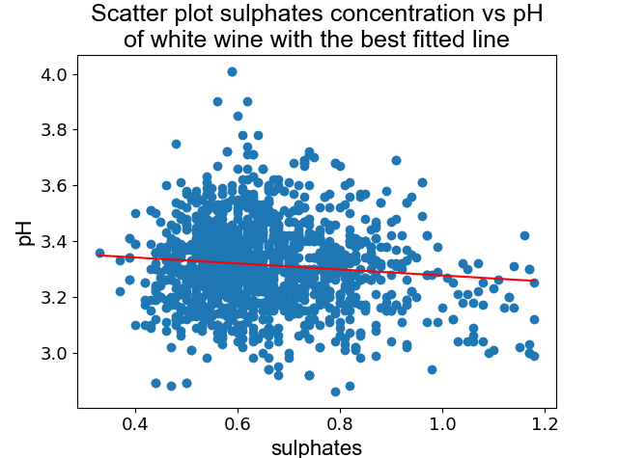
As a part of EDA covariance and correlation coefficient for sulphates concentration and pH were computed
and a scatter plot was created for these variables with the best fitted line. I created two scatter plots the left one
with possible outliers and the right one with filtered out values that are grater than 1.2
covariance=-0.005
Spearman coefficient=-0.08
confidence interval=(-0.042, 0.041)
p value=0.002
covariance=-0.002
Spearman coefficient=-0.052
confidence interval=(-0.042, 0.041)
p value=0.037

Slide 19
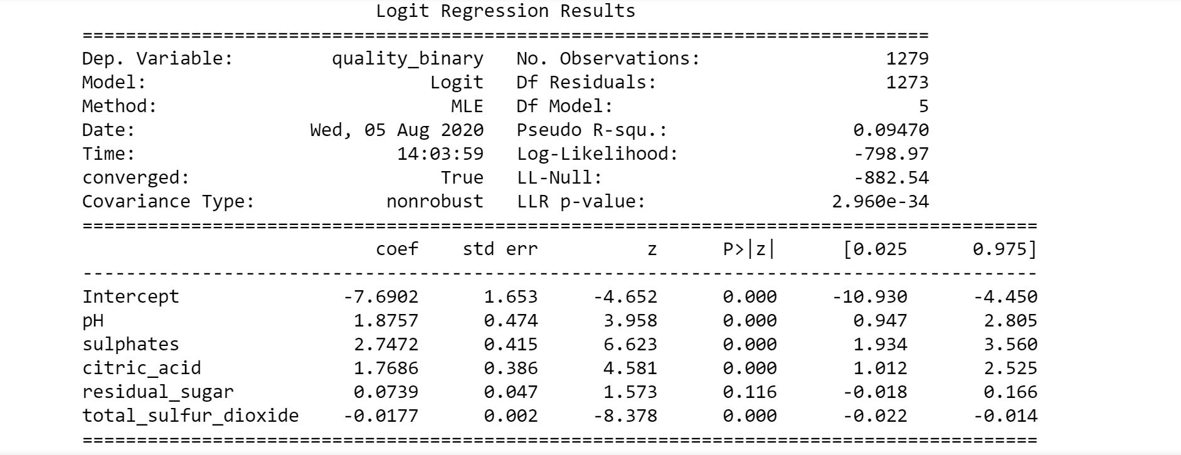
Logistic regression analysis of the white wine dataset
A model was developed to predict the quality of the white wine (low quality or high quality) based on following
Predictor variables: pH, sulphates, citric_acid, residual_sugar, and total_sulfur_dioxide. The output of the model
Is shown on the figure below. The accuracy of this model is 0.68

Slide 20
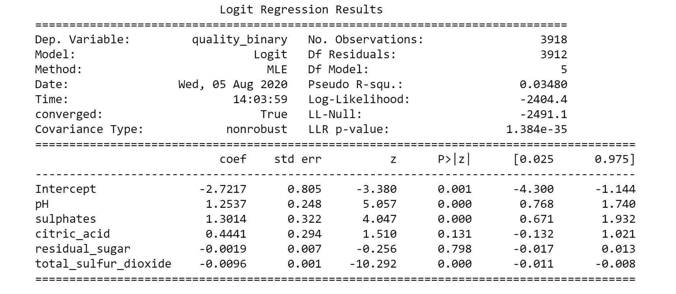
Logistic regression analysis of the red wine dataset
A model was developed to predict the quality of the red wine (low quality or high quality) based on following
Predictor variables: pH, sulphates, citric_acid, residual_sugar, and total_sulfur_dioxide. The output of the model
Is shown on the figure below. The accuracy of this model is 0.64

Slide 21
Conclusions of the logistic regression model
1. The residual sugar concentration is not statistically significant for both red wine and white wine.
2. The effect of the total sulfur dioxide is the smallest for both the red wine and the white wine.
3. For both the white wine and the red wine pH, sulphates and citric acid positively affect the quality
of wine.
4. Sulphate concentration has the strongest effect for both wines’ quality.
5. Accuracy for the white wine model is 0.68, and accuracy for the red wine model is 0.64.

Slide 22
Finally, statistical significance of difference in means between the residual sugar concentration of the red wine and that of the white wine was evaluated
The difference in means=3.862
P value =0 It means that the difference in residual sugar concentration between the red wine and the white wine is statistically significant.
The confidence interval (-0.209, 0.228)

